Slide 1
Wellcome Post-Award Webinar
20th June 2019

Slide 2
Agenda
Grant Balances Screen
Overview
Exporting
Organisational Spend Report
Best practice
Missing grant references
Final Expenditure Report
Best practice
Payment
Grant Start Certificates
Finding submitted GSC
Questions

Slide 3
Grant Balances Screen
Can be accessed by clicking
My Organisation > Grant Balances
Notes:
The Grant Balances Screen can provide a wide range of information for your organisation’s grants. They can be found in the Grant Tracker account that has financial reporting options. Once logged in click ‘My Organisation’ on the left hand side. In the next screen click ‘Grant Balances’

Slide 4
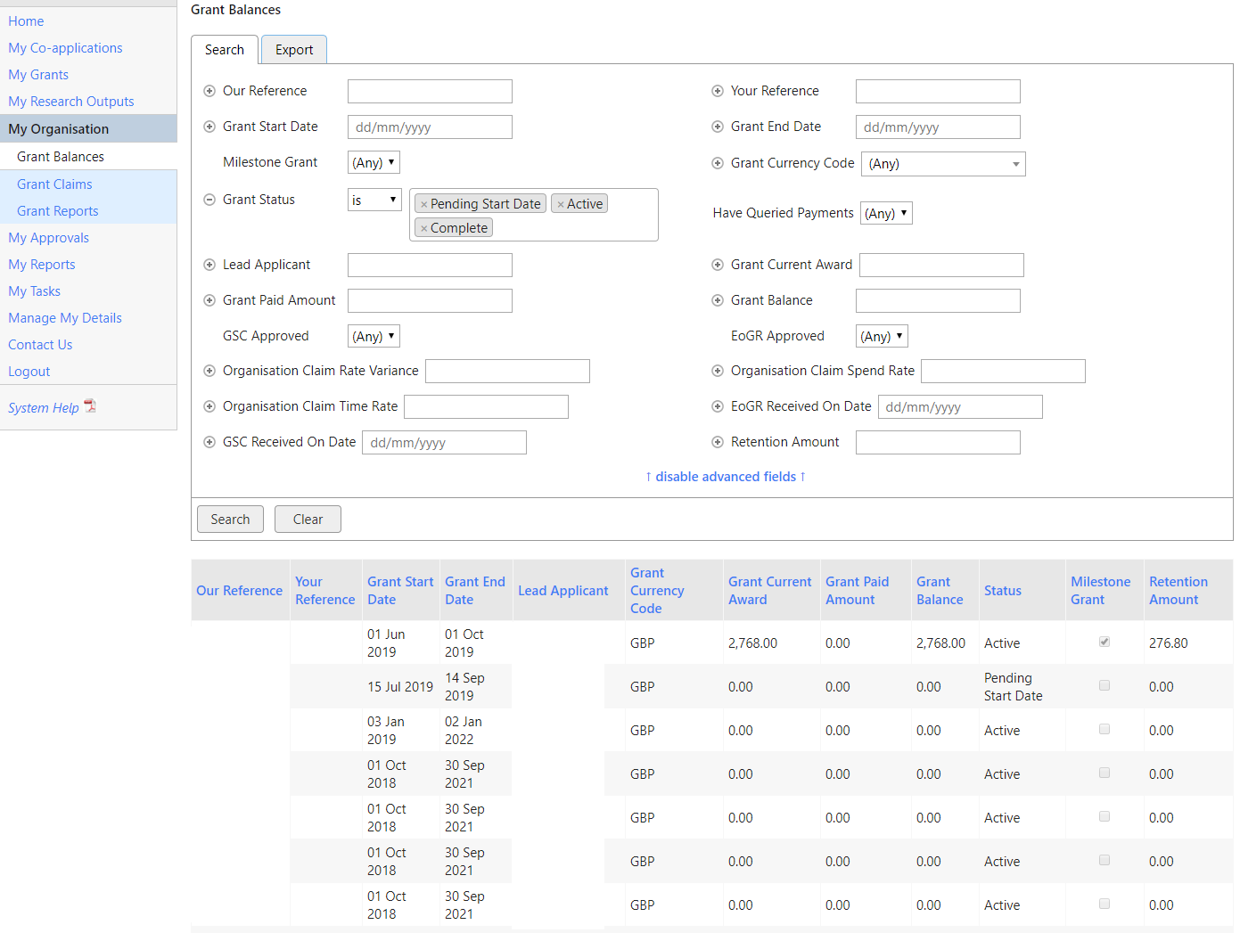
Notes:
From this screen the export button will bring up an option to produce an Excel spreadsheet on all Wellcome grants.

Slide 5
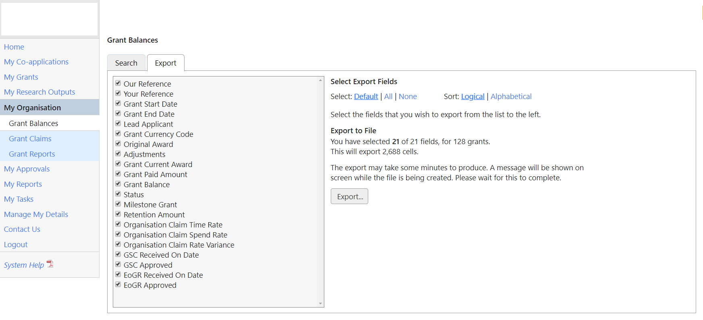
Notes:
Here you can choose the information to export into the spreadsheet.

Slide 6
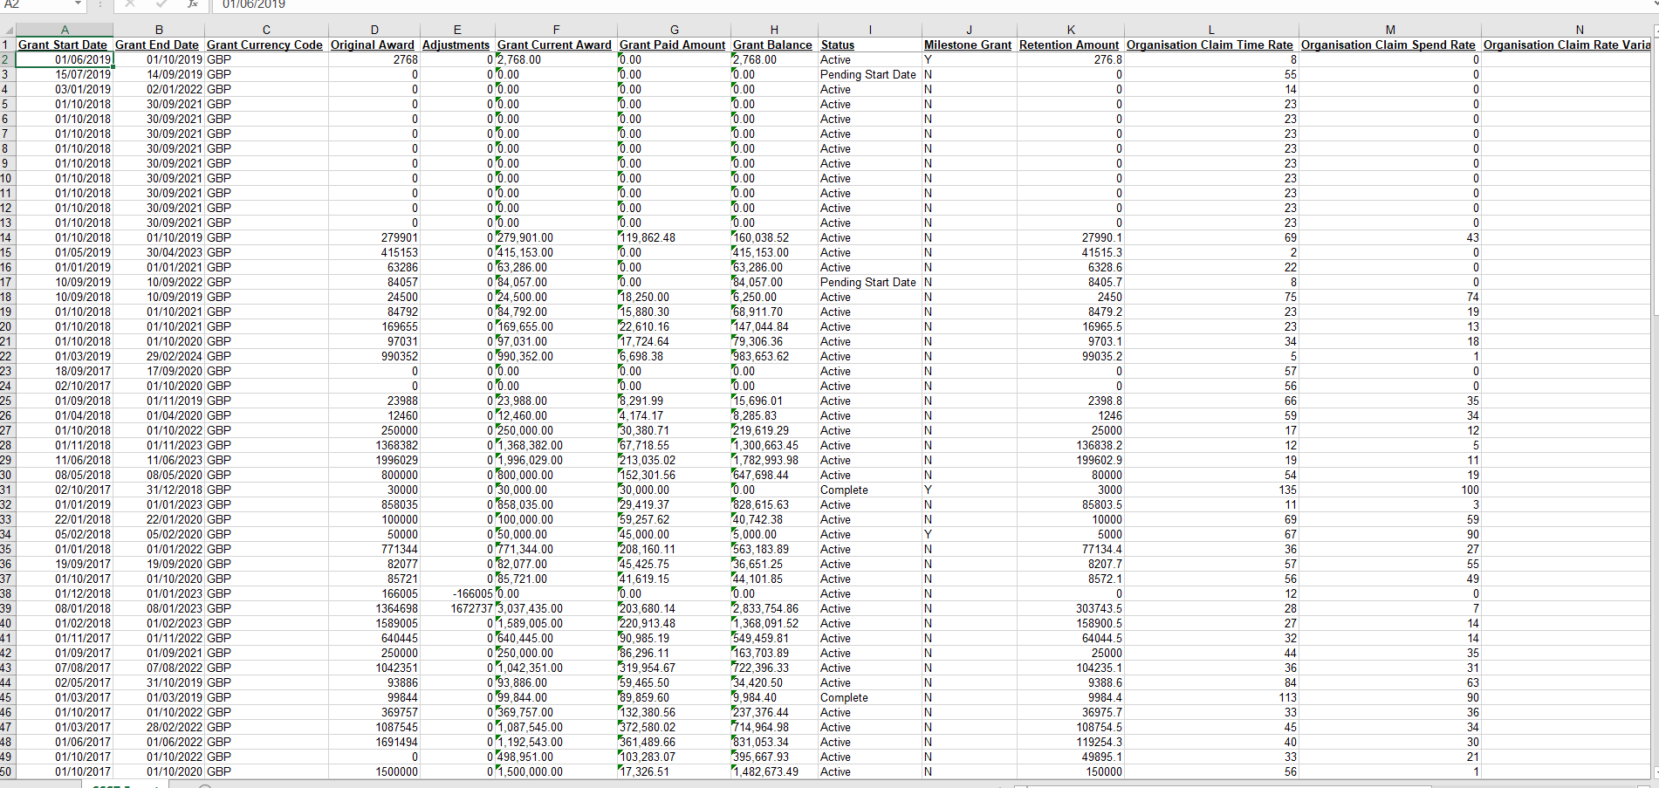
Notes:
The spreadsheet will look something like this

Slide 7
Organisational Spend Report (OSR)
No spend info on grant before OSR deadline.
Submit without info, provide a comment and add to next quarter OSR
Notes:
A common issue we have with OSRs is what to do if you do not have any spend information on a grant before the OSR deadline. We recommend submitting without the information and add a comment explaining why there is no spend.
In the next quarter’s OSR add the missing spend, plus that quarter’s spend. Add a note to explain this spend.

Slide 8
OSR
Full payment not received through OSR
Notes:
If full payment has not been received through the OSR the reason can be because the payment has been capped to meet retention. This can be checked on submitted OSRs

Slide 9
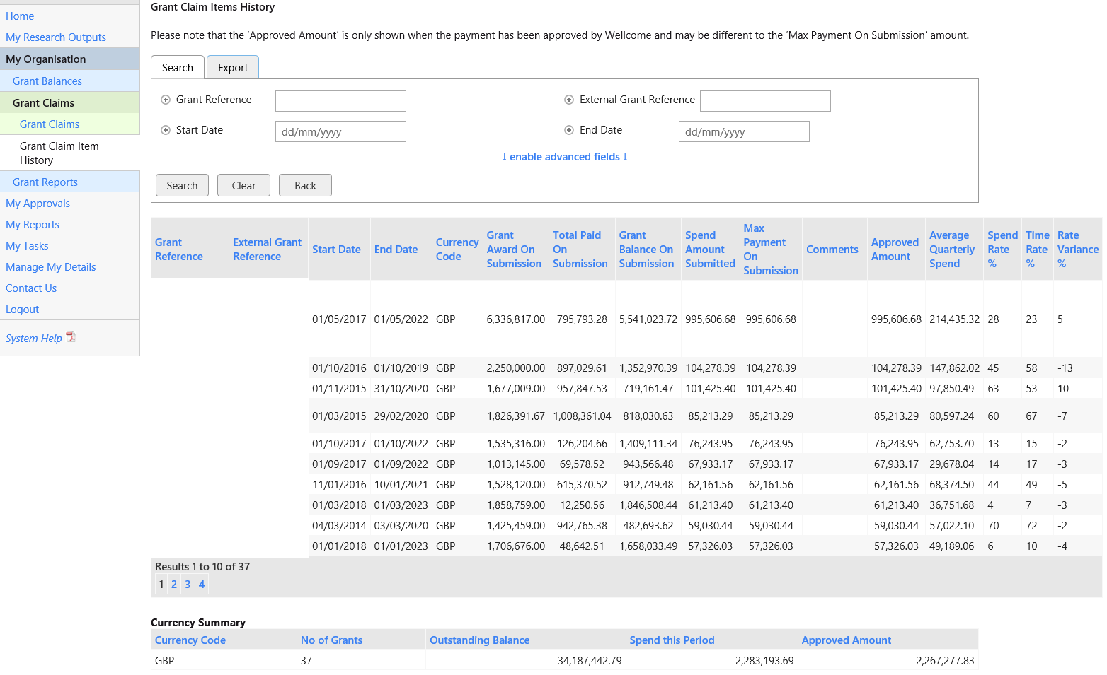
Notes:
To find a submitted OSR click ‘My Organisation > Grant Claims > Grant Claim Item History’. Once there you can click on a past OSR. The Spend Amount Submitted column will show how much has been submitted and the Max Payment on Submission column will show how much has been paid on this claim. If the 2 numbers are different we may have reached the cap.

Slide 10
OSR
Payment capped to meet retention
Rest of funds paid on submission of FER
Notes:
If this is the case the rest of the funds will be paid on submission of the FER

Slide 11
OSR
Can’t find grant on OSR? 3 things to check:
Is the grant non-milestone?
Has GSC been submitted and approved?
Has grant been paid to retention?
Notes:
If you are expecting a grant to be on an OSR and it is not, there are 3 things you need to check:
Is the grant non-milestone?
Has the GSC been submitted and approved?
Has the grant been paid to retention?

Slide 12
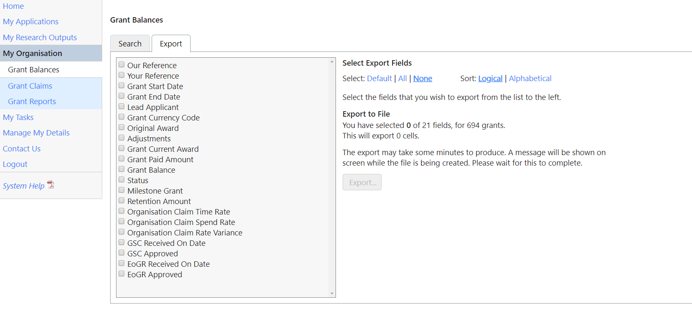
OSR
Notes:
These can be checked by choosing them in the export section of the Grant Balances page.

Slide 13
OSR
Claiming spend for more than one spend period
Request change of start date to bring in line with first claim
Explain any spikes and dips
Spend time variance is large
Zero spend or same as last quarter comment will be mandatory.
Notes:
We would like to encourage the use of the comments section when submitting an OSR. This can reduce the amount of queries from our Grant Payments Team. Comments would be appreciated if you are:
Claiming spend for more than one spend period
Need to request the change of a start date to bring in line with the first claim
Explaining any spikes and dips
Explaining a spend time variance that is large
If there is a zero spend or it is the same as the last quarter a comment will be mandatory.

Slide 14
Final Expenditure Report (FER)
Can I amend a submitted FER?
NO!
Notes:
We are not able to amend submitted FERs

Slide 15
FER
Can I get an extension on submitting?
YES!
Contact your GPT business partner.
grantpayments@wellcome.ac.uk
Notes:
However we are able to extend the deadline for submission of FERs. So if you need more time to get exact figures please do ask. We’ll be happy to accommodate. To request an extension please contact your Grants Payment Team business partner. If you don’t know who that is contact grantpayments@wellcome.ac.uk.

Slide 16
FER
Costs on FER don’t match Award Letter?
Contact the Grant Manager.
Contact your GPT business partner.
grantpayments@wellcome.ac.uk
Notes:
If the figures in the FER do not match those in the Award Letter you will need to discuss this with Wellcome. If you know who the award’s Grant Manager is please contact them. If you don’t know who that is contact your GPT business partner, or grantpayments@wellcome.ac.uk.

Slide 17
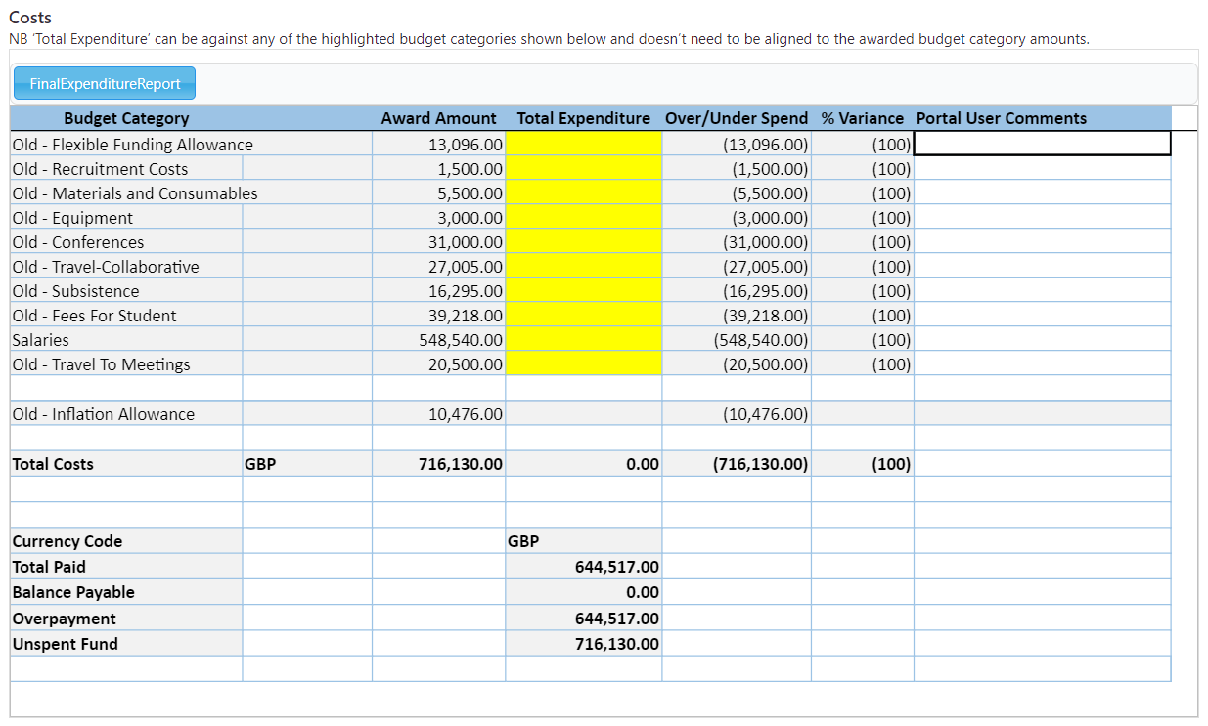
FER
Large Variances
Unexpected Overspend
Large Project Funding Changes
Notes:
As with OSRs we would like to encourage adding comments to FERs. Reasons to add comments can be:
Large Variances
Unexpected Overspend
Large Project Funding Changes

Slide 18
Payment
Currently trialling a monthly payment cycle.
Payment will be received on the last Friday of every month
Notes:
Payments are currently being trailed on a monthly payment cycle. As such you should receive payment on the last Friday of every month.

Slide 19
Grant Start Certificate (GSC)
Check which Grant Tracker account has GSCs
Contact gtsupport@wellcome.ac.uk
Found in the ‘My Reports’ section
Notes:
If you are looking for submitted GSCs, you should first double check which of your organisation’s Grant Tracker accounts these can be found in. If you are unsure of this you can contact us on gtsupport@wellcome.ac.uk and we will be able to check for you.

Slide 20
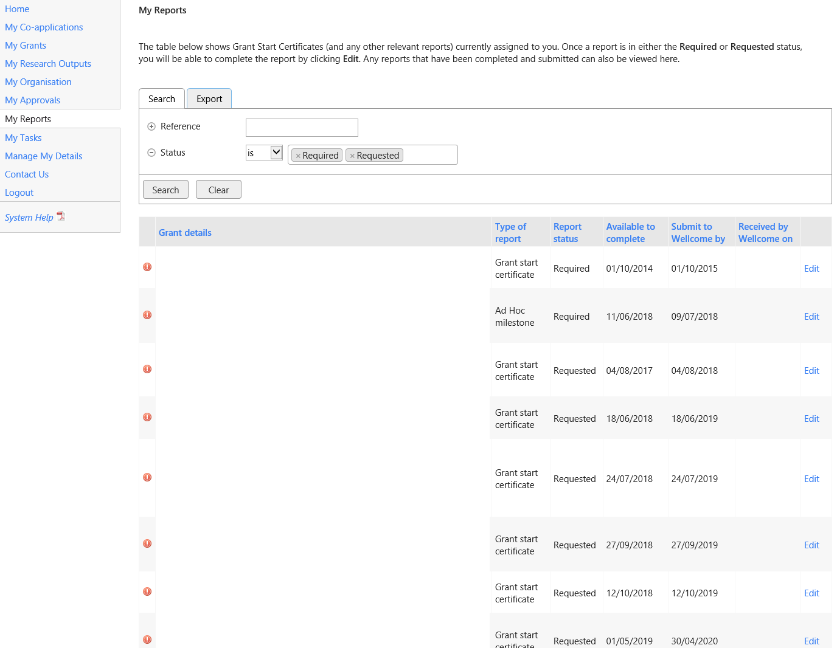
Notes:
Once identified they can be found in the ‘My Reports’ section.
The first view will bring up any certificates awaiting submission. Removing the ‘Required’ and ‘Requested’ filters will bring up submitted GSCs

Slide 21
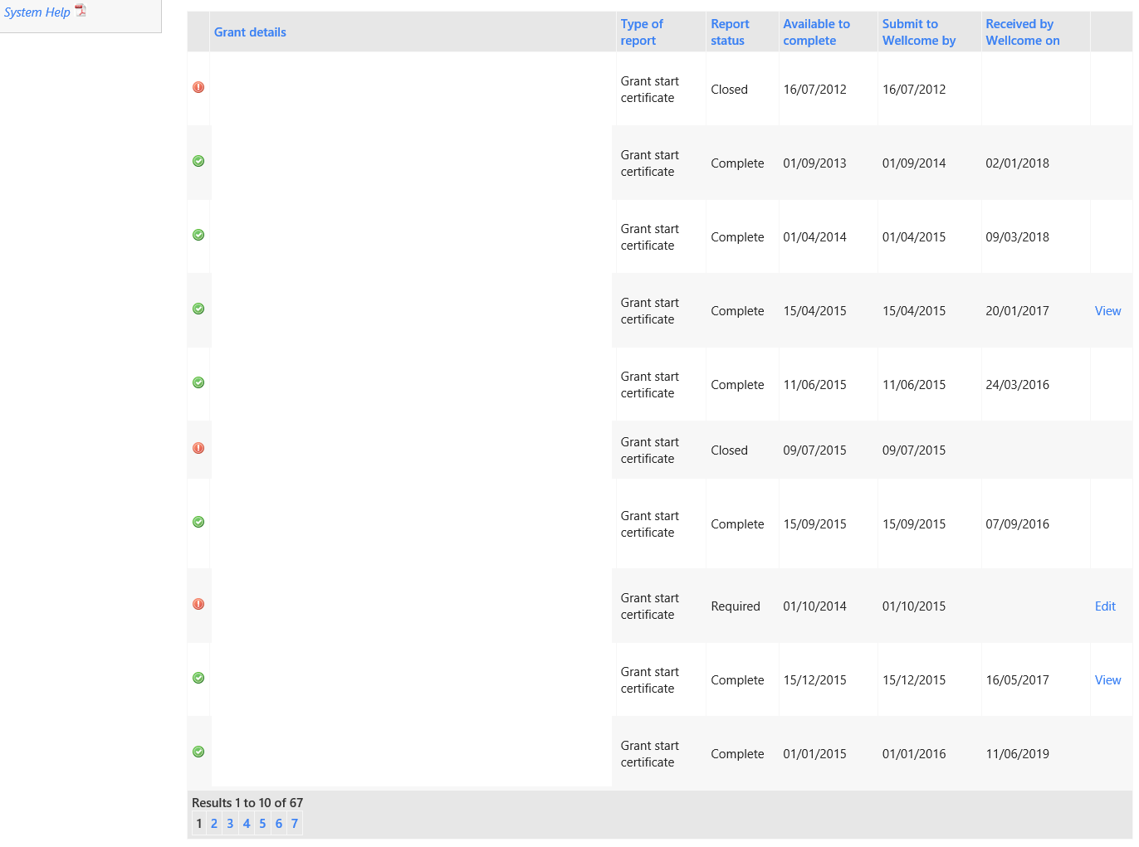
Notes:
Here you can see the submitted GSCs

Slide 22
Questions
Do variances need to be approved prior to FER submission?
Large variances in spend against the awarded budget headings quite often indicate significant changes in direction of a grant. Changes in use of awarded funds should be communicated to Wellcome before or as they take place.

Slide 23
Questions
What is classified as a large variance (FER)?
There is no set formula due to a variety of award types and their values. A sense check is performed against over/under spends in relation to the type of award. In particular funds awarded for Animals and Equipment. Any supporting FER comments on spend variances would assist in reducing the amount of queries generated at the FER review stage. More guidance on this subject is on Wellcome’s website: https://wellcome.ac.uk/funding/guidance/how-to-manage-your-grant-budget

Slide 24
Questions
What is classified as a large variance (OSR)?
There is no set formula due to a variety of award types and their values. A sense check of an OSR claim for each grant is performed to ensure that spend/time rate variance and the amount claimed are relevant to the type, size and duration of an award. Any supporting OSR comments for quarter on quarter spend and spend/time rate variances would assist in reducing the amount of queries generated at the OSR review stage.

Slide 25
Questions
What reasons do you accept for an extension to an FER?
All FER submission extension requests are reviewed and considered on a case by case basis. The main point here is to keep communication channels open and communicate any delays in FER submissions to Wellcome or risk a grant being closed off and any remaining funds written off.

Slide 26
Questions
We have found that we are unable to submit an FER if there is an overspend on the project. Is there a way that we can report the total expenditure?
This is a system limitation where total reported spend cannot exceed the total award. However you are always welcome to provide the total/actual spend within the comment fields of the FER.

Slide 27
Contact
Issues using Grant Tracker
gtsupport@wellcome.ac.uk
Any payment related issues
grantpayments@wellcome.ac.uk
Any grant related queries
Individual grant manager / gtsupport@wellcome.ac.uk
Notes:
If you have any issues using the Grant Tracker site please contact gtsupport@wellcome.ac.uk
If you have FER, OSRS or payment queries please contact grantpayments@wellcome.ac.uk
If you have any queries relating to grant processes, such as the extension of an end date or maternity leave procedure, please contact the grant manager for that individual grant. If you do not know the manager please contact gtsupport@wellcome.ac.uk and we can let you know.

